Slide 1
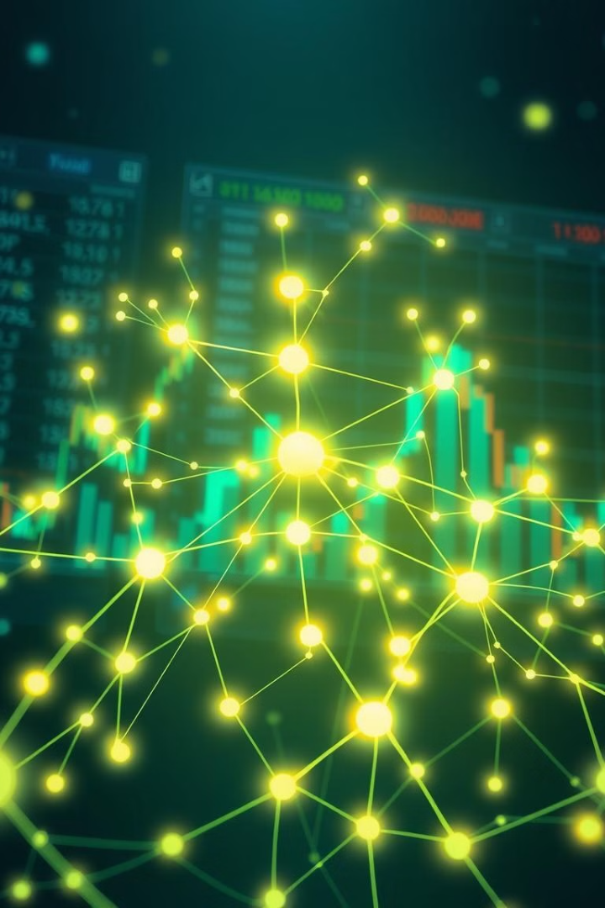
NeuroStockViz: Visualizing Stock Correlations
Welcome to NeuroStockViz, a novel approach to exploring stock price correlations through neural network-inspired visualizations. This project aims to transform how financial analysts and researchers perceive and interact with complex market data.
Presented By: Ishant Kundra, Rahaan Gandhi, Tanishq Chopra

Slide 2
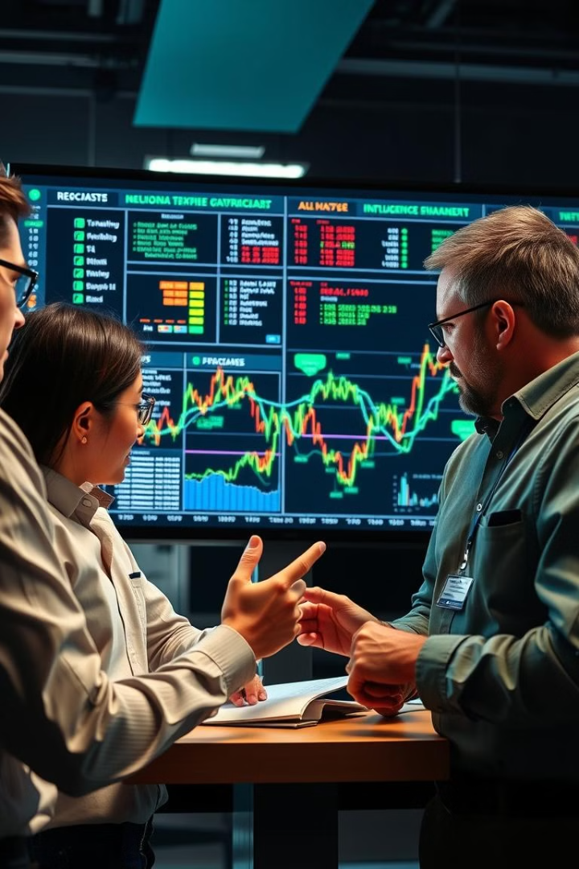
Key Research Questions
Our project is driven by a set of core research questions designed to explore the potential of neural-inspired visualizations in the financial domain.
1
Enhanced Interpretability
Can we visualize financial stock correlations using neural-like network structures for better interpretability?
2
Influential Stocks
What are the most influential stocks within specific sectors or the whole market?
3
Pattern Identification
How can such visualizations help in identifying patterns during market volatility?
4
Method Advantages
What advantages does this method have over traditional heatmaps and tables?

Slide 3
Related Work & Inspirations
NeuroStockViz builds upon existing research while introducing innovative approaches to stock market visualization. We have carefully considered the strengths and limitations of previous methods to inform our design and implementation.
Portfolio Visualizer
Minimum Spanning Trees
Stanford's Differential Graph Transformer
Portfolio Visualizer's heatmaps offer pairwise correlation viewing but lack interactivity, a key feature we aimed to enhance.
Minimum Spanning Tree models from DileQuante demonstrate sectorial clustering using graph theory, inspiring our network-based approach.
Stanford's Differential Graph Transformer leverages GNNs for temporal financial prediction, influencing our dynamic correlation idea.

Slide 4
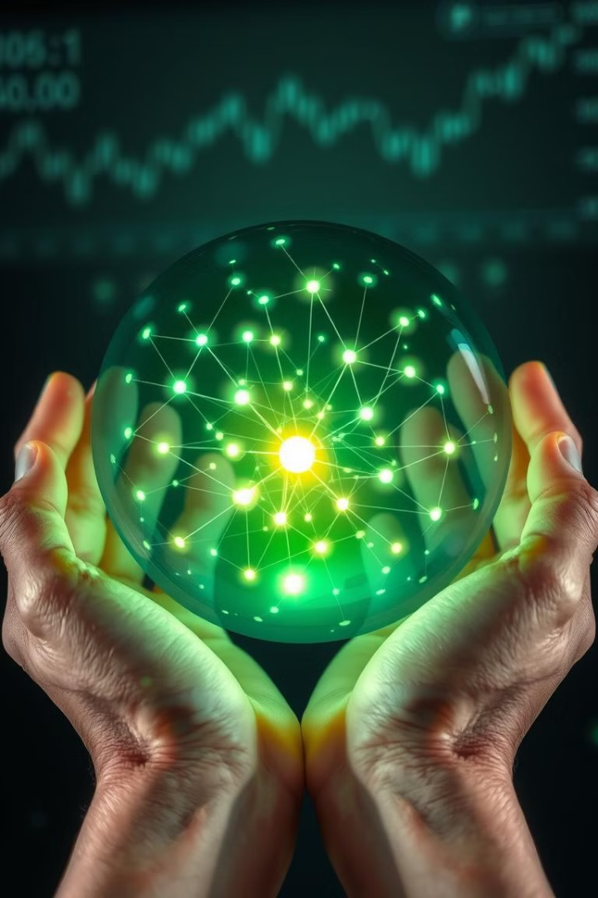
Key Contributions of NeuroStockViz
NeuroStockViz offers several key contributions that set it apart from traditional methods, providing financial analysts with a powerful new tool for understanding stock market dynamics.
Bridging Finance & Network Science
Interactive Web-Based Tool
Intuitive visualizations integrate financial data with network science, offering fresh insights.
Custom filters by year, threshold, stock, or sector allow tailored exploration.
Traditional Comparison
A correlation heatmap is included for traditional comparisons.
NeuroStockViz enhances the ability to see the interactions of the stock market in a new light and is more intuitive than more conventional methods.

Slide 5
Requirement Analysis: Functional and Non-Functional
To ensure NeuroStockViz meets the needs of its users, we conducted a thorough requirement analysis, identifying both functional and non-functional requirements critical to the system's success. These requirements guide our development process and ensure a user-friendly and reliable tool.
Functional Requirements
Non-Functional Requirements
Select stock, sector, year, correlation threshold.
Quick rendering for good user experience.
Generate visual graphs and charts on selection.
Reliable correlation and data integrity.
Hoverable nodes/edges for insights.
Intuitive user interface.

Slide 6

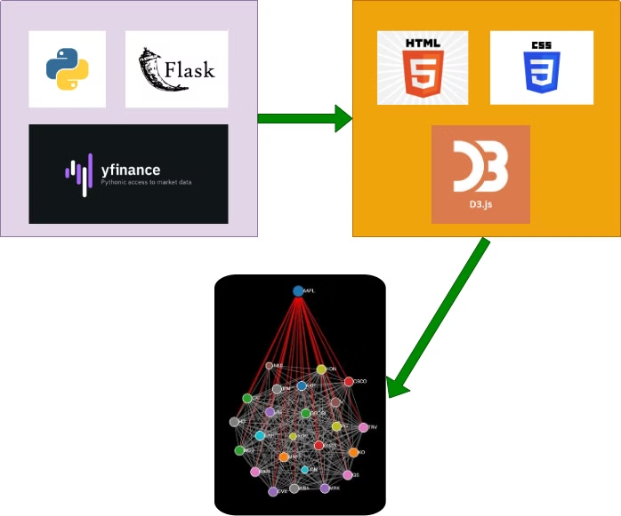



System Overview: Architecture and Data Flow
NeuroStockViz employs a robust system architecture designed for efficient data processing and visualization. The system is built using a combination of frontend and backend technologies, ensuring a seamless user experience from data retrieval to interactive exploration.
Frontend
Built using D3.js, HTML5, CSS, JavaScript.
Backend
Python Flask server with yfinance and Pandas.
Data Flow
User input triggers Python backend, which returns a filtered correlation matrix for frontend visualization.

Slide 7
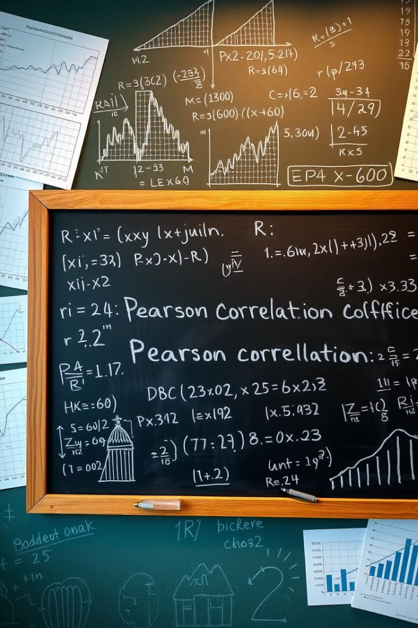
Algorithm Design: Computing Correlations
The core of NeuroStockViz lies in its algorithm for computing stock price correlations and generating network visualizations. This algorithm leverages established statistical methods and visualization techniques to provide meaningful insights into market dynamics.
Data Retrieval
Retrieve historical stock price data from Yahoo Finance.
Normalization
Normalize and align time series data for selected stocks.
Coefficient Computation
Compute Pearson correlation coefficients.
Graph Creation
Create a graph with stocks as nodes and correlations as edge weights.

Slide 8
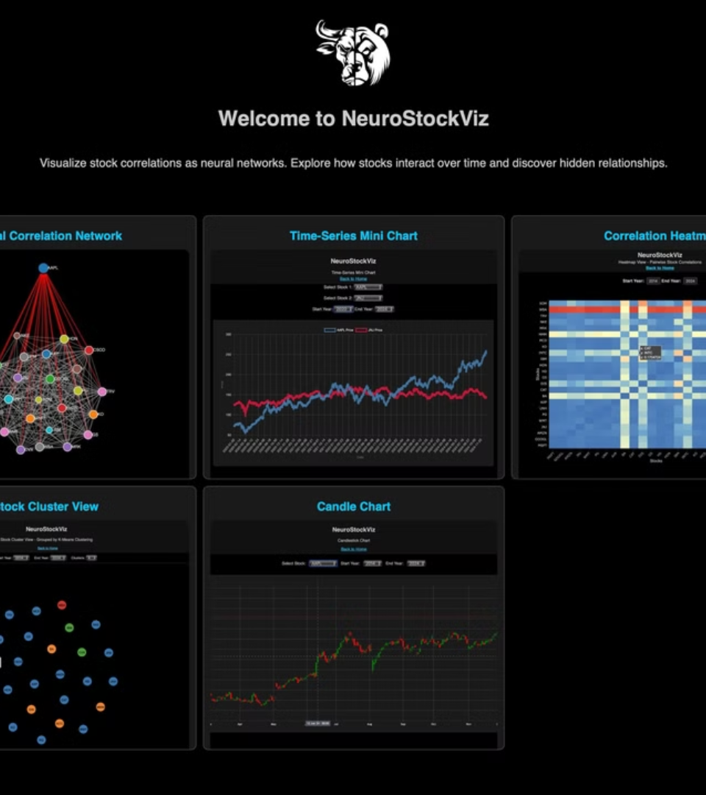





Interface/Interaction Design
User experience is at the forefront of NeuroStockViz, guiding the design of an intuitive and interactive interface.
Neural Graph Panel
Hover to inspect stock and connection strength on the neural graph panel.
Mini Time-Series Chart
Track selected stock prices over time to verify correlation intuitively.
Heatmap Panel
Conventional 2D correlation matrix for familiar analysis.
Cluster View
Cluster view for similarity analysis.
Candle Chart
Traditional stock price candle chart for fluctuation analysis.

Slide 9
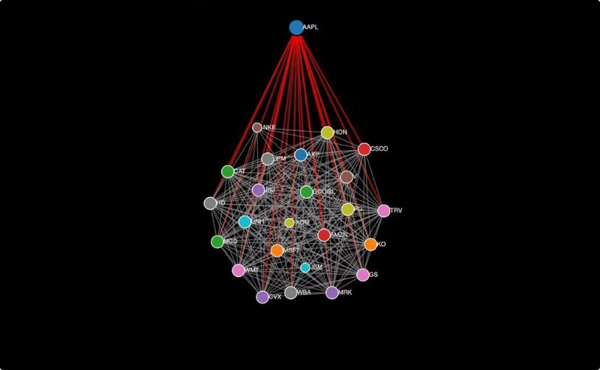
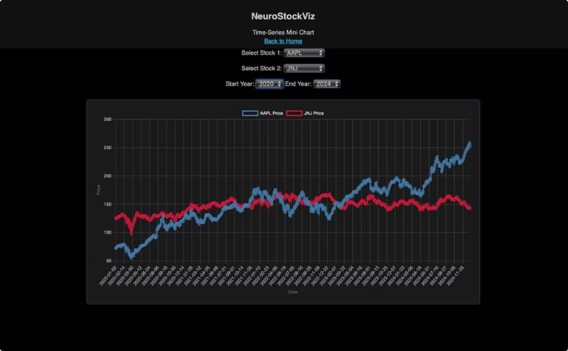
Screenshots & Demo
To illustrate the capabilities of NeuroStockViz, we present a series of screenshots showcasing its key features and functionalities, offering a glimpse into the visual insights it provides. A live demo will further enhance understanding.
Neural Graph Layout
Mini Time Series Chart
Showcasing correlation density with a neural-style graph layout.
Showcasing Time Series Chart of stock prices

Slide 10
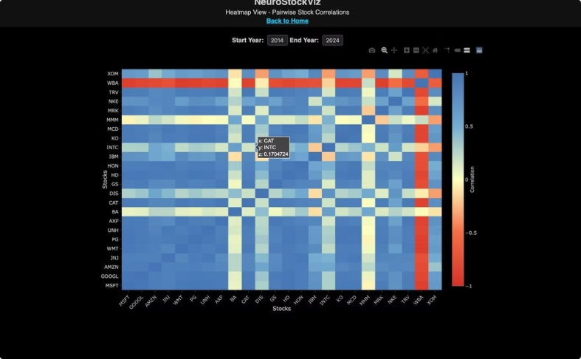
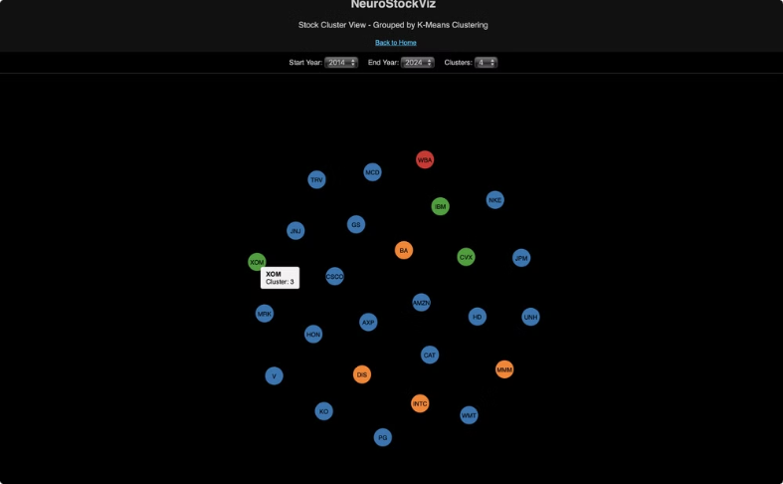
Screenshots & Demo
To illustrate the capabilities of NeuroStockViz, we present a series of screenshots showcasing its key features and functionalities, offering a glimpse into the visual insights it provides. A live demo will further enhance understanding.
Heatmap Panel
Cluster
Showcasing full correlation heatmap.
Showcasing Cluster view.

Slide 11
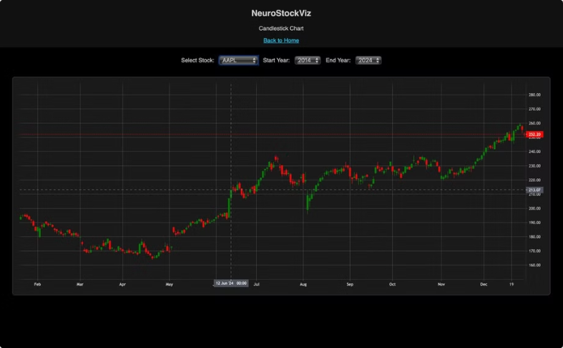
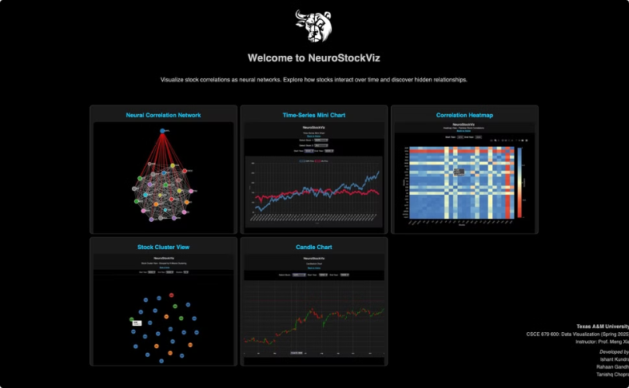
Screenshots & Demo
To illustrate the capabilities of NeuroStockViz, we present a series of screenshots showcasing its key features and functionalities, offering a glimpse into the visual insights it provides. A live demo will further enhance understanding.
Candlestick Chart
Main View
Showcasing traditional Candlestick price chart.
Showcasing Home page.

Slide 12

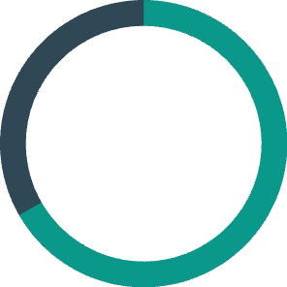
Evaluation and Feedback
To assess the effectiveness and usability of NeuroStockViz, we conducted a thorough evaluation involving a diverse group of users, gathering valuable feedback to guide future improvements and enhancements.
66.7%
Found the graph insightful vs. traditional charts.
User testing group included 10 finance students, and 5 analysts. Survey feedback included various suggestions like adding sector-level summaries and export options. This feedback helped us to shape final development and future work.

Slide 13

Future Work
Enable exporting visualizations as PNG/PDF.
Implement historical comparison tables for performance benchmarking.
Expand dataset coverage to include broader indexes such as S&P 500 or NASDAQ-100 stocks.

Slide 14

Group Members Work Allocation
Ishant Kundra:
Data Engineering, backend data pipeline.
Predictive insights, network modeling.
Rahaan Gandhi:
Correlation calculation and exploratory analysis.
Interface and visualization interactivity development.
Tanishq Chopra:
Descriptive analysis of stock correlations.
Frontend visualization implementation and UI enhancements.

Slide 15




Reflections
Team Dynamics
Employed effective collaboration strategies
Technical
2
Iterative design improved through continuous user feedback
Faced challenges syncing frontend visuals with backend computations
1
Project Management
Improved responsiveness via asynchronous data handling
3
Mixed success with timeline adherence
Task division influenced progress both positively and negatively

